Slide 1
Lost At Sea
Genre: Survival Adventure

Slide 2
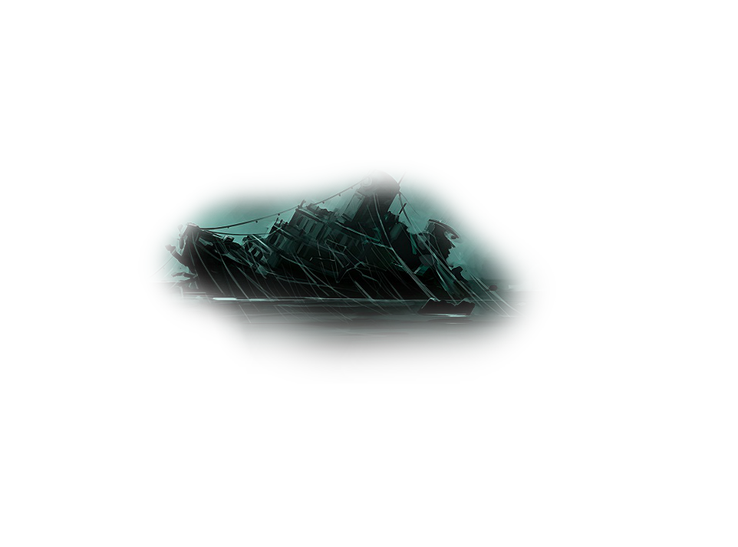
A storm brews, your crew become uneasy and disjointed…
Take on the role of a sea captain
Experience the degradation of your crew’s sanity, as you fail to reach any sight of land
Chaos festers within the ranks…
Decide who lives and who dies as you force your crew to walk the plank
Battle strange monsters, fierce enemies and the relentless tides of mother nature
Survive until you make it to land, with or without your crew, or be forgotten at sea forever

Slide 3
Gameplay
The player will begin by being briefly introduced to their first mate, who will guide the player throughout the game and act as an informant
As the player becomes more familiar with his crew, he will gradually feel the effects paranoia and psychosis developing
Overall gameplay and environment takes inspiration from games such as Sunless Sea (LOSE YOUR MIND. EAT YOUR CREW. DIE.)
Throughout the game the player will have to fend off random attacks from both
pirates and monsters alike, while battling harsh weathers
The ending may differ depending on surviving crew or actions the player
takes during their voyage

Slide 4
Why should you vote for this game?
There Are existing resources to help kick start development of the game
Mods that add ships, enemies, monsters and weapons
Events and interactions are not set in stone, adopting a modular design
The premise of the game includes both action and strategy, so it caters to whatever floats your boat

